Slide 1
PowerShell Core: Who, What, Where, When & Why!
Kevin Laux

Slide 2

Kevin Laux
Senior Platform Engineer in RTP
PowerShell Advocate
Leader RTPSUG
User since v3

Slide 3

What is PowerShell?
Notes:
CLI with the purpose of task automation and configuration management for Windows based Operating Systems
-Built into Windows since Server 2008
-Available for Windows XP SP2 and Server 2003 SP2 (Feb 2008 over a decade)
-CMDlets are unique and give PowerShell its POWER!
-verb-noun easy to understand
Uses PowerShell ISE for scripting environment
.Net Framework
The latest version is 5.x
Like the ISE Microsoft has said that PowerShell will only receive security updates going forward.

Slide 4

What is PowerShell Core?
Notes:
-PowerShell v 6.0
-based on .NetCore instead of .Net Framework
-Open Source and runs on Linux, Mac OS, and Windows. (Windows IoT, Arm support as well)
-Installs sxs with PowerShell 5.0
-pwsh vs powershell.exe
-Microsoft works actively on PowerShell Core. PowerShell, is in a state of extended support. Microsoft has no plans to add features to PowerShell, but it will release critical bug fixes and security updates.
-PowerShell Core has no ISE USE VS CODE!
-missing things like:
web forms, get-credential is all cli based
no out-gridview
limited cmdlets
Supports Remoting over SSH as well as WinRM

Slide 5
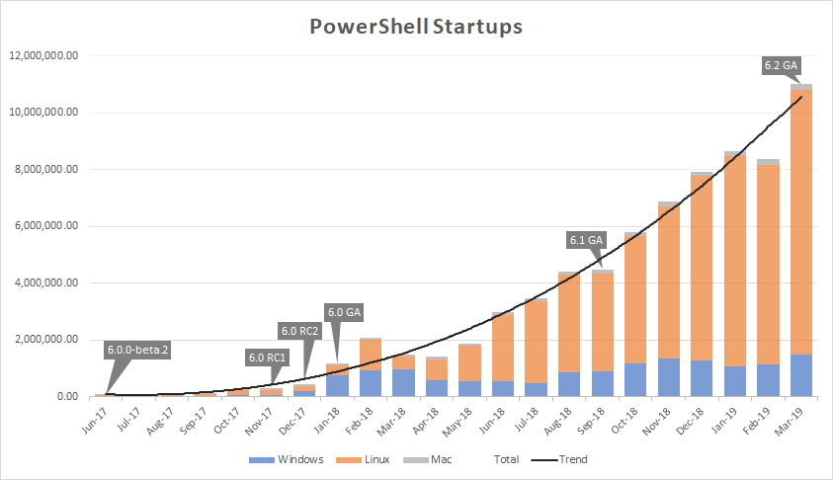
PowerShell 7
Based on .NetCore 3.0
Bulk of users Linux not Windows
90+% Compatibility
GA soon?
“A full replacement of Windows PowerShell 5.1.“

Slide 6
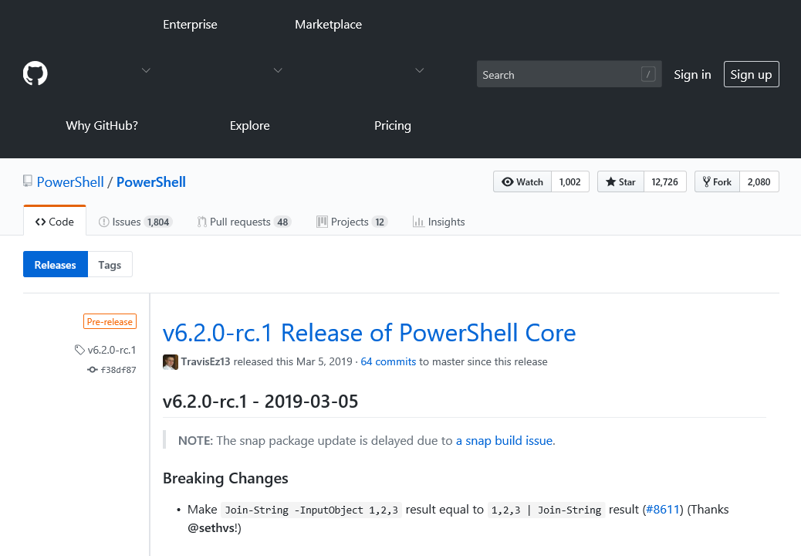
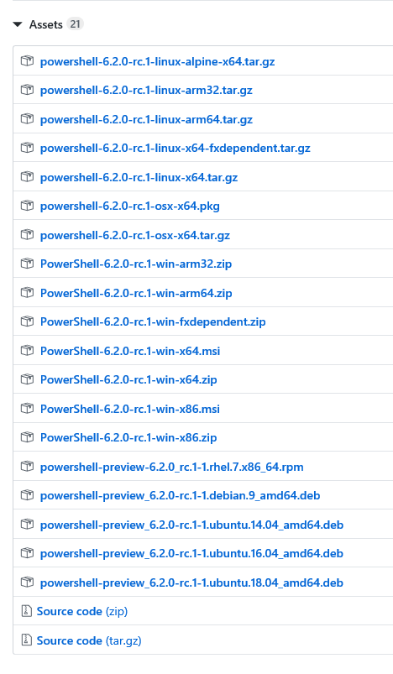
Install
Notes:
-Github for install files
-Version for everything including .rpm, .deb for linux

Slide 7
Useful Links
https://github.com/PowerShell/PowerShell
https://docs.microsoft.com/en-us/powershell/scripting/overview
https://www.thomasmaurer.ch/2019/07/how-to-install-and-update-powershell-7/
https://www.thomasmaurer.ch/2016/04/using-ssh-with-powershell/
https://www.thomasmaurer.ch/2019/04/setup-powershell-ssh-remoting-in-powershell-6/

Slide 8
Demo
Getting Started (Install)
PowerShell vs PowerShell Core
OpenSSH
PowerShell Core on Linux
Remoting between Windows and Linux
Script Demo

Slide 9
Windows Install
iex "& { $(irm https://aka.ms/install-powershell.ps1) } -UseMSI -Preview“
Linux Install
wget https://aka.ms/install-powershell.sh; sudo bash install-powershell.sh -preview; rm install-powershell.sh

Slide 10
Information
Personal:
Twitter: https://twitter.com/rsrychro
Github: https://github.com/kevinlaux
Linkedin: https://www.linkedin.com/in/kevinlaux/
Research Triangle PowerShell Users Group:
Website: https://rtpsug.com/
Meetup: https://www.meetup.com/Research-Triangle-PowerShell-Users-Group/
Youtube: https://www.youtube.com/c/RTPSUG

